Slide 1
Hot Potato:
Who Will End Up Paying for Open Access?
Sue Ann Gardner
Scholarly Communications Librarian
University of Nebraska-Lincoln
IAMSLIC / EURASLIC – Brugge, Belgium
September 30, 2009

Slide 2

Hot Potato
Rules of the game:
Players stand in a circle and pass around an object representing the potato (a ball, a bean bag, et al.).
After some signal, the person holding the potato is out of the game.
This is repeated until the last person, who has not been left with the “potato” after any of the rounds, wins.
image from http://crackthecode.us/images/hot_potato.png

Slide 3

Who Will Pay for Open Access?
Publishers
Authors
Institutions/
Governments
Readers
image from www.eslpod.com

Slide 4
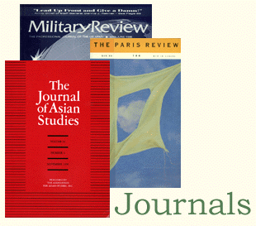
Scope
I will refer to scholarly works only, those that are created by academics, whose intent is not to be monetarily compensated for their writing.
image from www.lib.pdx.edu

Slide 5
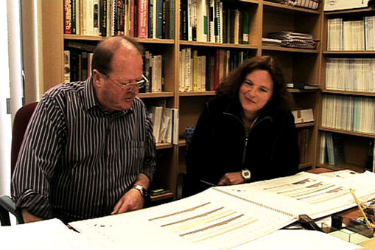
Scholarly Communication
Central and essential to research is unimpeded communication between researchers, often through publication in journals, proceedings and books.
Researchers also need to communicate with students as well as readers who are not within the academy. The public at large has an ongoing need for information.
image from www.sciencelearn.org.nz

Slide 6
The Public’s Right to Know
Groups such as the U.S.-based Alliance for Taxpayer Access aim “to ensure that the published results of research funded with public dollars are made available to the … public, for free, online, as soon as possible.”
John Willinsky, Rick Johnson, and others, have pointed out that universities have a moral duty to make the results of research freely available to the public in light of tax payer contribution to the work.

Slide 7
Freeconomics
Discussion in the popular press about free access to content via the Web. This is a false concept.
The question should be: for whom does open access cost, and for whom is it free?
Next question: is the answer to the above as it should be?

Slide 8
Scholarly Communication Participants
Authors | Publishers | Aggregators | Libraries
Create content | Systematically format and disseminate peer-reviewed content | Aggregate content | Make content accessible to readers

Slide 9

In a Nutshell …
Professor (salaried)
  Does research
  Writes a paper
  Sends the article to a journal (perhaps
  paying page charges)
Publisher
  Adds value to the article (copyediting, formatting, arranging for peer review, producing, etc.)
  Charges libraries to obtain the re-worked content
  Limits how the author may use the work from then on
  image from etc.usf.edu

Slide 10
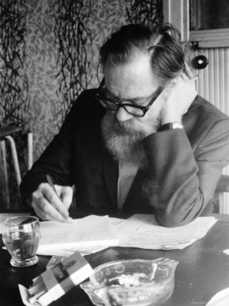

Tangible and Intangible Compensation
Scholarly authors’ compensation for having articles published:
Salary
Readers
Citations/Impact
Legacy/Contribution to collective body of literature in a field
Basis for salary increases, affects ability to secure external funding
image from konicki.com
image from sfsu.edu

Slide 11

Publishers, Revenue
Commercial publishers need to generate revenue, or they would not survive.
image from hotnichechips.com
Are there models of revenue generation in which an author retains the right to freely make his/her work accessible to readers?

Slide 12
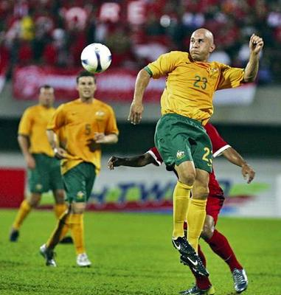
Green vs. Gold
Peter Suber and others have defined varying levels of access:
Gold standard
Green standard
Pale green standard
Australia’s Socceroos, image from: Sydney Morning Herald

Slide 13


Open Access: What Is It?
“Open-access (OA) literature is
digital, online, free of charge,
and free of most copyright and
licensing restrictions”—Peter Suber image from http://nahsl.org/2009/suber.jpg
“Open Access (OA) means that
electronic scholarly articles are
available freely at the point of use”
—Keith Jeffery image from http://w3.org

Slide 14
Green vs. Gold:
It’s Not Just About Content
Green
  author’s version posted
  the content is available; but important aspects are missing
  in its worst form: quasi-open access; form of grey literature
Gold
  publisher’s version posted
  a paper is placed in the continuum of scholarship, formatted and enumerated consistently for all readers, indexed and cataloged
  true open access

Slide 15
Publishers’ Versions
A paper is placed in the continuum of scholarship
It is formatted and enumerated consistently for all readers
It is indexed and cataloged.

Slide 16
Citations
Citations provide the unifying thread
throughout scholarship.
Academic communication involves citing of works. With access merely to content--with ephemeral URLs and various versions of the same content available--the use of citations in scholarly communication will be impaired.
    http://www.unl.edu/digcomm/libsci1 (Mar. 2007)
    http://unl.edu/dc/libsci1 (May 2008)
    http://digitalcommons.unl.edu/libsci1 (Feb. 2009)

Slide 17
Citations: Author’s Version vs.
Publisher’s Version
Professor A cites the OA “author’s version” at http://... which changes servers sometime after posting. This version is not categorized by subject, nor is it indexed or cataloged.
Professor B cites the OA published version. The article is
  one in a sequence
  associated with others of the same subject
  enumerated (year, volume, pagination)
  indexed and cataloged.
  Its citations are tracked which defines a journal’s impact factor.

Slide 18

Needs of Authors, Needs of Publishers
Authors need Publishers need
readers, and citations. economic viability.
image from ew.com
Are these truly conflicting interests? NOT NECESSARILY.

Slide 19
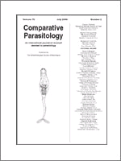
A Sustainable Example
Comparative Parasitology
Published by the Helminthological Society of Washington, and edited by members of the society.
Produced—but not published—by Allen Press.

Slide 20
A Sustainable Example (Cont.)
HelmSoc, hired Allen Press to perform certain editorial, production and bookkeeping functions, but Allen does not have any rights to the content of the journal.
Three members of the ed. board of CP contribute 2-3 work wks/yr to do the most expensive editorial tasks. It would not be cost-effective for HelmSoc to hire Allen for:
  graphics editing
  text editing
  peer review administration

Slide 21
A Sustainable Example (Cont.)
Comparative Parasitology costs $65 per year. It never gets cut during budget downturns in libraries. It is widely available and, therefore, used broadly.
Allen Press contracted with BioOne to receive a flat rate per article from CP.
Every time someone downloads a CP paper from BioOne, BioOne gives HelmSoc a royalty fee.

Slide 22
Flow of Revenue
Subscribers HelmSoc
Libraries BioOne Allen Press

Slide 23
A Sustainable Example (Cont.)
This arrangement results in:
  HelmSoc making money on their journal due to subscriptions, low editorial costs and receipt of royalty fees from BioOne.
  Allen Press making money because HelmSoc pays them to do the formatting and production AND because BioOne pays them for each article Allen Press releases to BioOne from CP.
  BioOne making money by getting subscriptions from libraries for access to its database.
  EACH PARTY MAKES MONEY IN THIS SCENARIO

Slide 24
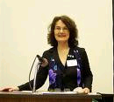
Library Philosophy and Practice
Founded in 1998, Library Philosophy and Practice is an online-only journal, managed entirely by the founders, two librarians in the U.S. Members of the editorial board and others peer review the articles.
The cost of the journal is the pro-rated salaries of the librarians involved and nothing more.

Slide 25

Library Philosophy and Practice (ISSN 1522-0222) is available at no charge and without a subscription. Tables of contents are listed on the homepage and articles for each issue are accessible from the tables of contents. Library Philosophy and Practice is indexed in Library, Information Science & Technology Abstracts (LISTA), DOAJ, Library Literature & Information Science, and SCOPUS
LPP articles are available from the University of Nebraska--Lincoln, the University of Idaho, and the University of Nebraska--Lincoln Libraries' Digital Commons.

Slide 26
Change Is Afoot
SPARC, Scholarly Publishing and Academic Resources Coalition. They are “working to correct imbalances in the scholarly publishing system … [through] educating, advocating policy change and incubating sustainable publishing endeavors.”
Creative Commons licensing
Author addenda to publishing contracts
Public Knowledge Project
Canadian Centre for Studies in Publishing Press (Simon Fraser Univ.)
Project Gutenberg
Newfound Press (University of Tennessee, Knoxville)
Cambridge University Press and Cambridge University Library
OAIster, the union catalog of digital resources

Slide 27


Digital Commons at UNL
With 1.5 FTE faculty, the University of Nebraska-Lincoln Digital Commons; BEPress platform
Over 36,000 articles, theses, dissertations and books Over 3 million full-text downloads since 2005
Paul Royster, Scholarly Communications
Coordinator; Sue Ann Gardner, Scholarly
Communications Librarian
http://digitalcommons.unl.edu

