Slide 1
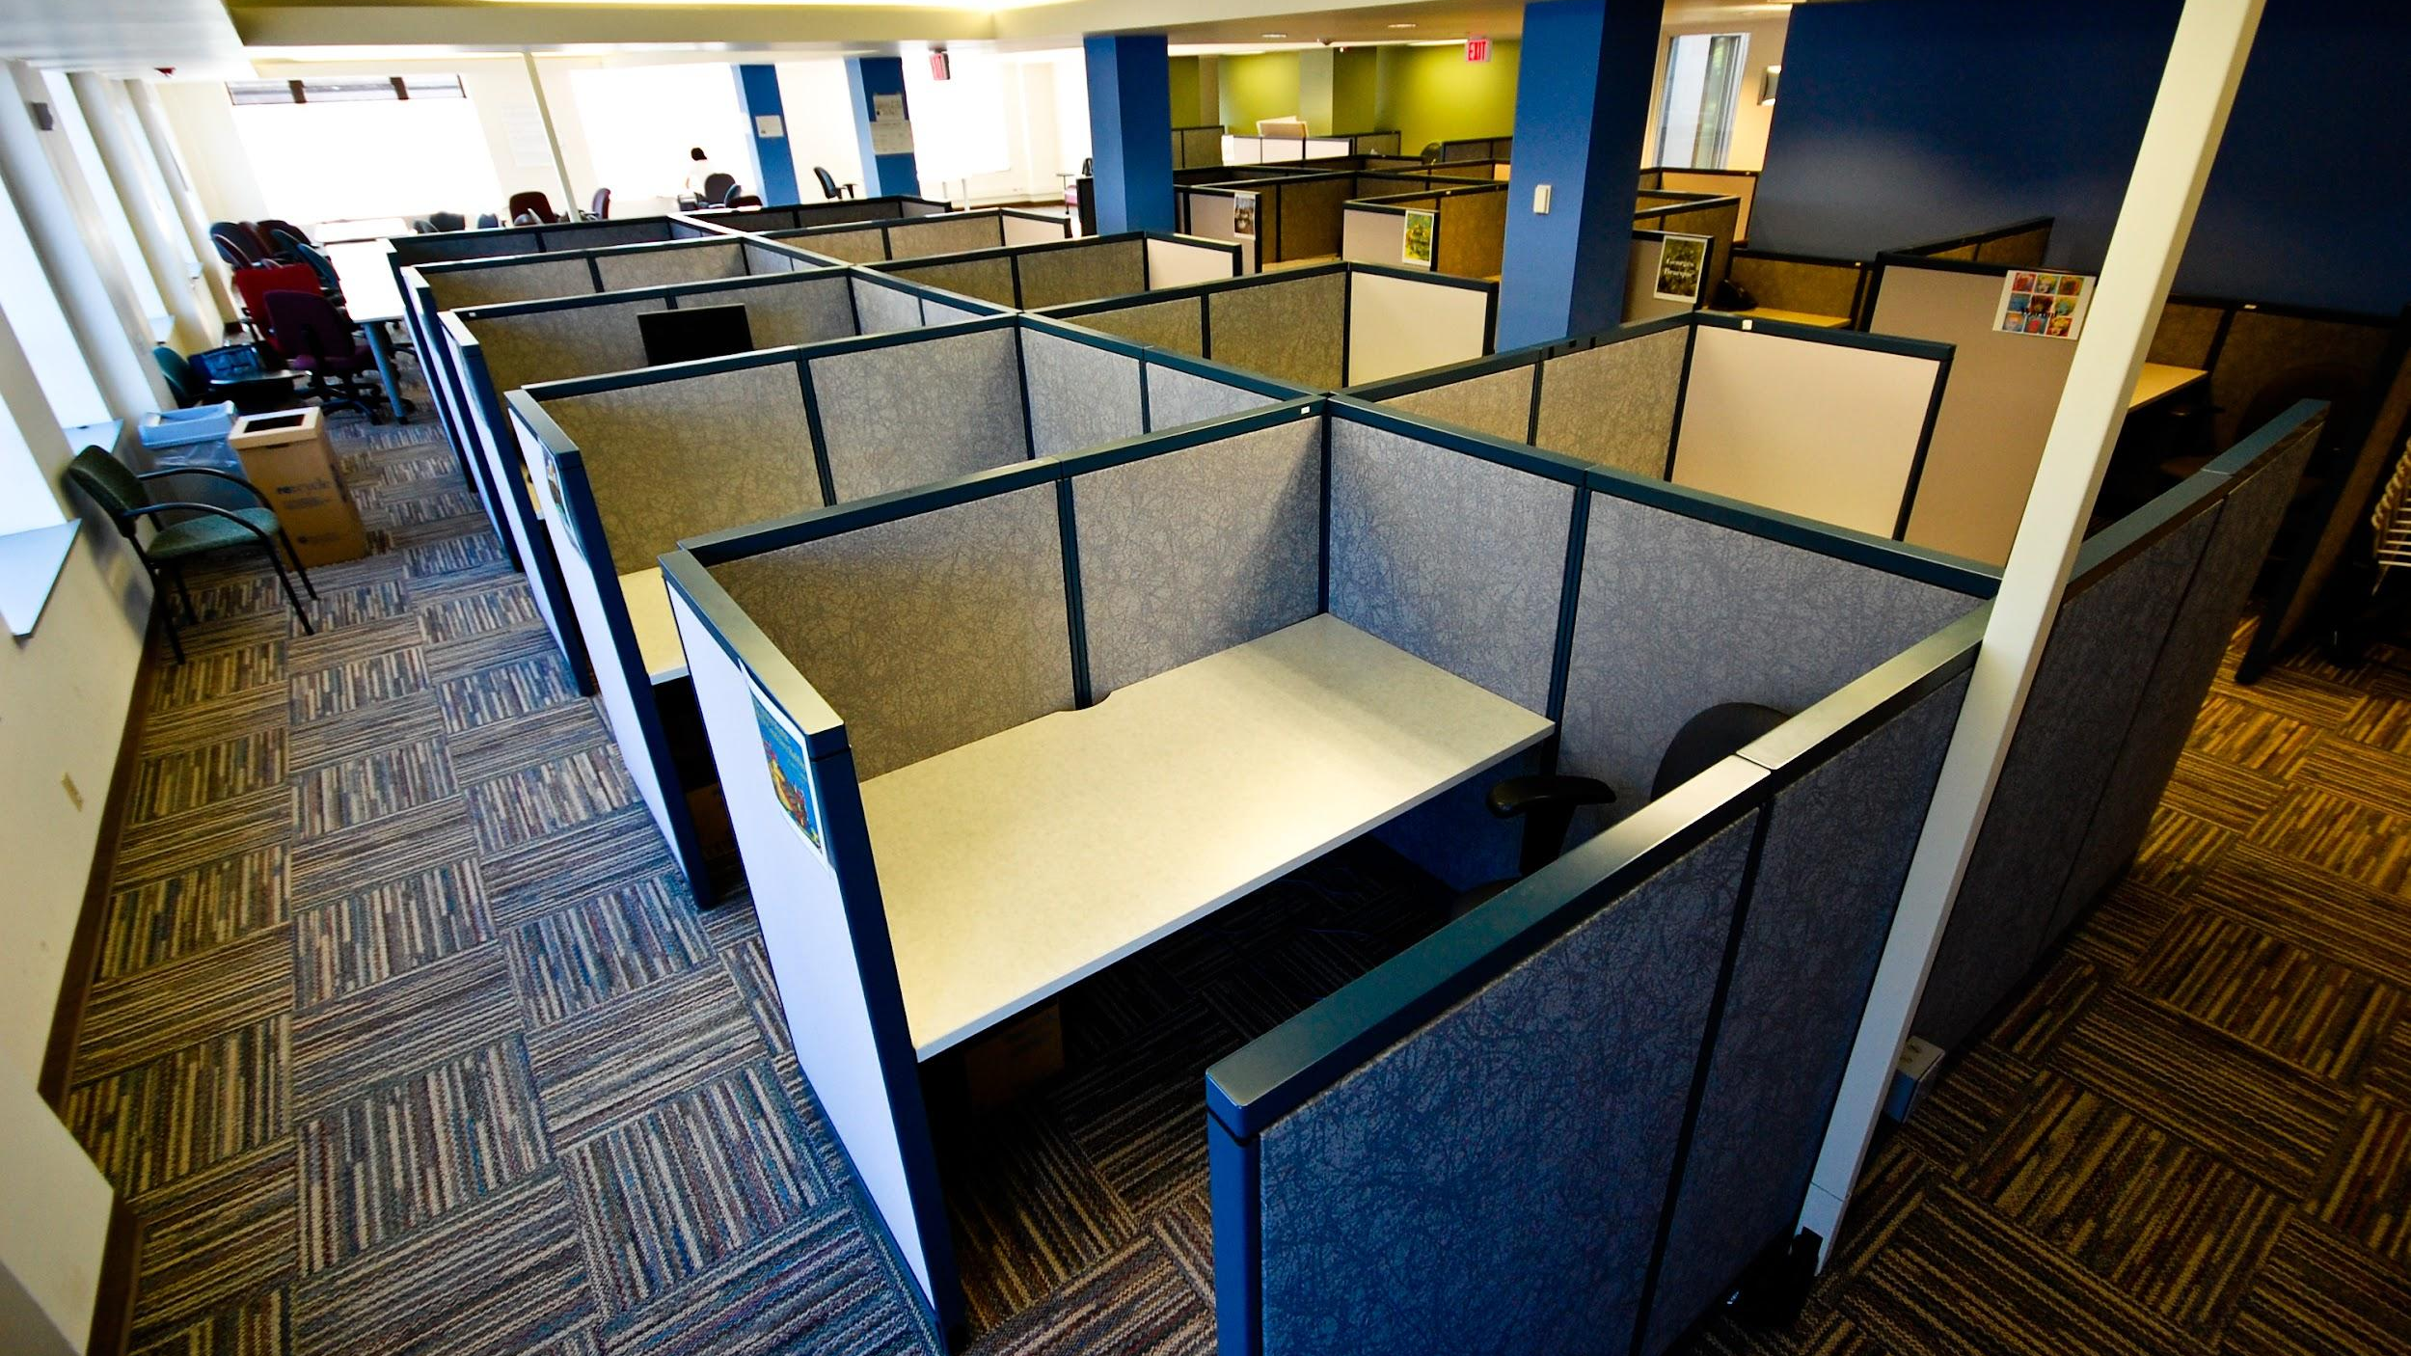
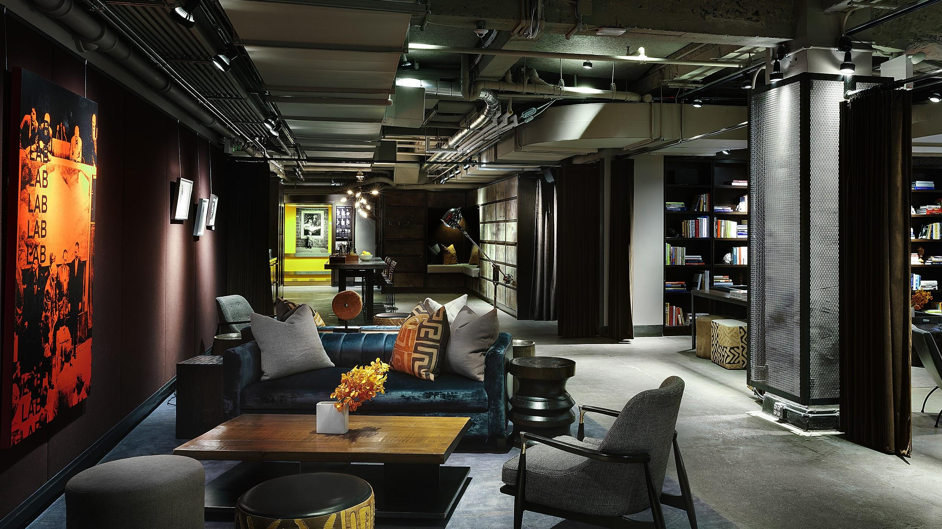
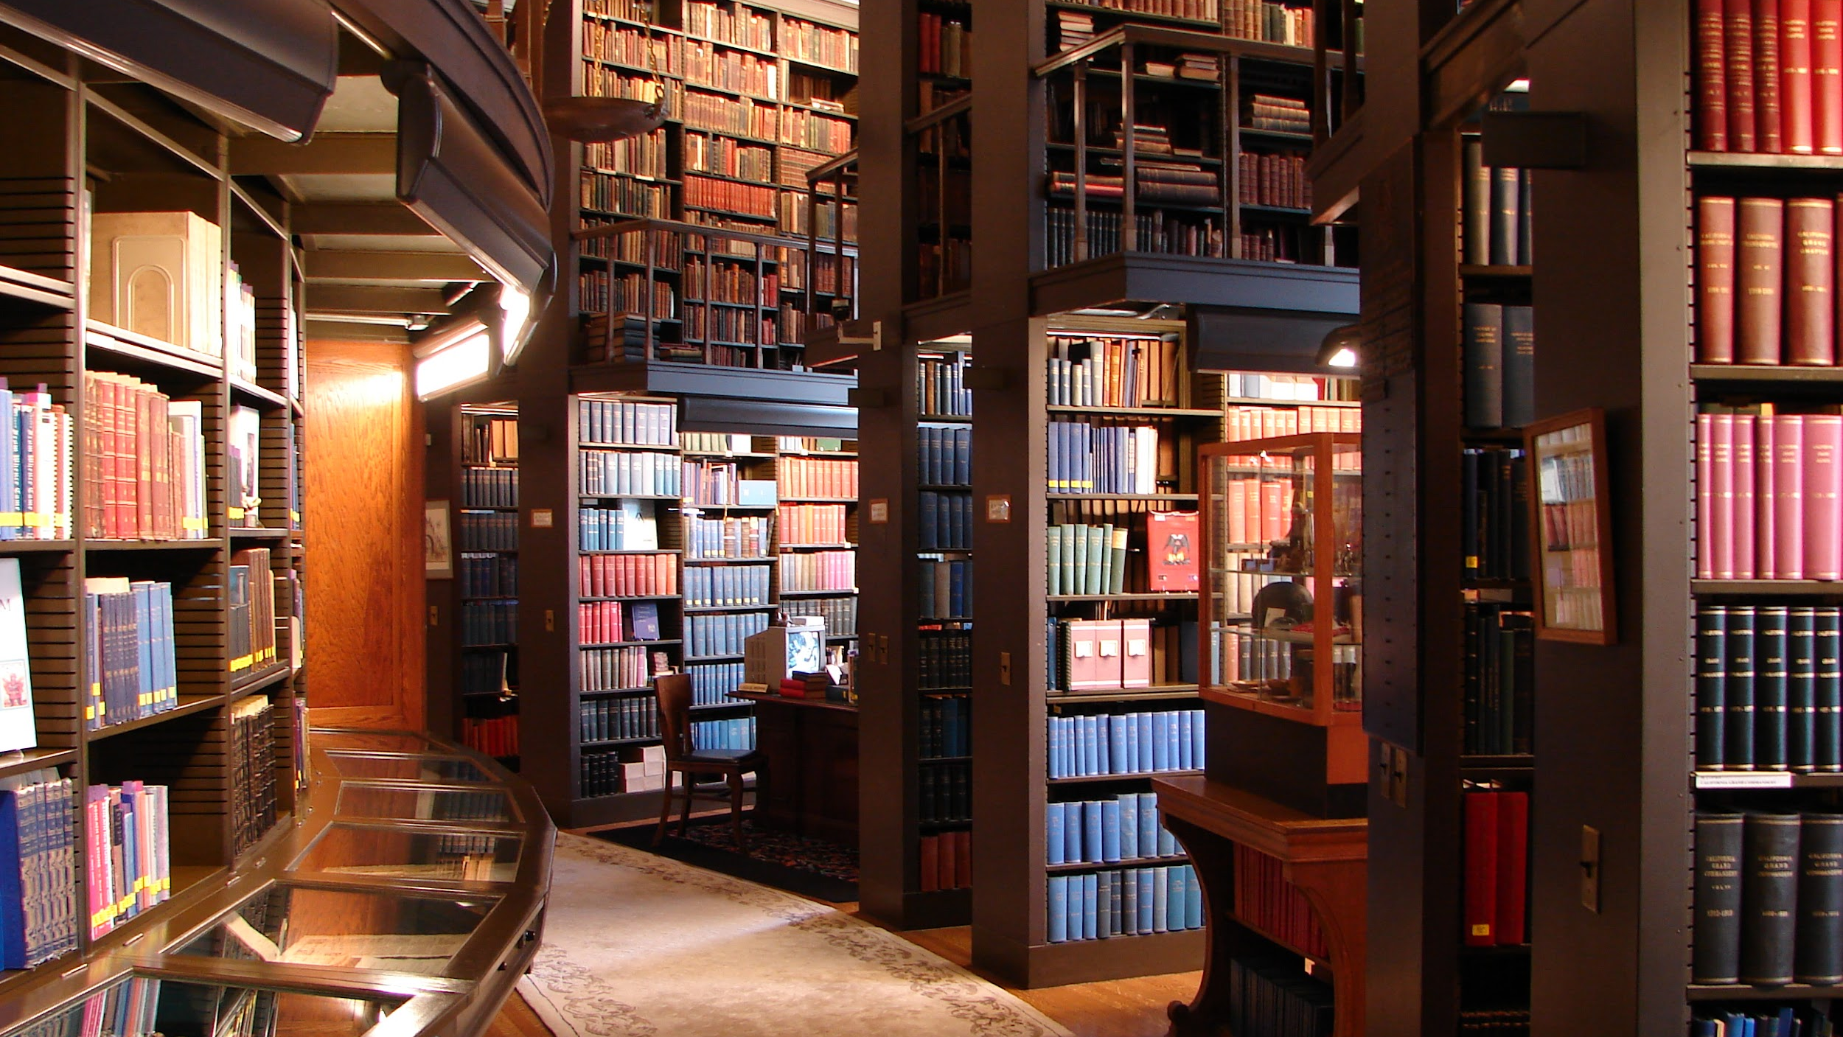
DEIR in Chemistry Libraries
Kiyomi D. Deards, University of Nebraska-Lincoln, July 27, 2020
CC by SA2.0 by Asa Wilson, CC0 by Unsplash, CC3.0 by Senseitells, CC by 2.0 by J_B
Notes:
Background Image Description: 4 different library images from upper left going clockwise- 1) Large room with grey and black mini-cubicle study spaces. 2) Dark library with comfortable lounge couch and chairs with dark stack with books. 3) Wooden table with laptop, open book with pen and tea cup and saucer in a open space. 4) Class multi-story ceiling height dark brown wood bookcases and classic fancy leather and wood chairs and tables.
Work cultures can vary wildly depending on where you’re a chemistry librarian.
Challenges you may encounter include:
Institutional cultures
Systemic bias
Social Factors
The level of formality, emphasis or not on individuality and DEIR, you position of power and relationship to others power, and the culture of your workplace will influence how much DEIR you can initially build into your institution and your job.

Slide 2
TODAY’S DEIR TOPICS:
Formal Experience
Institutional
Library
Chemistry Librarian
Notes:
Background Image Description: Black circuit board with blue circuits on the outer edges.
Today I will give a brief overview of my formal DEIR experiences and what I’ve learned from them. Examples of Institutional DEIR activities, Library DEIR activities, and Chemistry Librarian DEIR activities. After the end of my presentation slides are more slides with links to a variety of resources and publications.

Slide 3
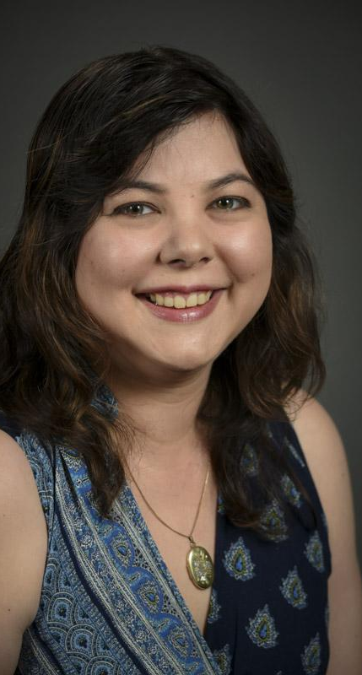
Recent Formal DEIR Experience
Chancellor’s Commission on the Status of Gender and Sexual Identity
ARL VPO for Leadership and Diversity
Women in Physical Sciences Conference
Notes:
Slide background: Black with white frame edged in black.
Image: Japanese American woman with shoulder length dark brown hair, light skin, wearing a sleeveless blue on blue pattern dress and a gold locket.

Slide 4
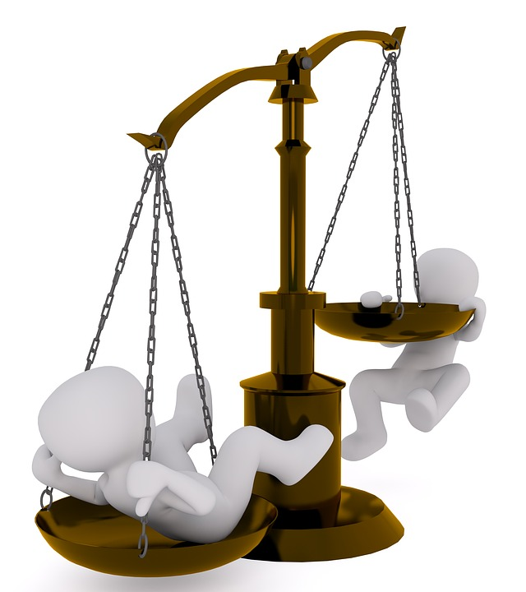
Institutional DEIR
The
Balance
Of
Power
Notes:
Background Image Description: Black circuit board with blue circuits on the outer edges.
Images: Left hand image of two white stick figures on a bronze balance scale, one is on it’s back pushing the scale down and the other is trying to cling on to the rising scale. The second image is on the right hand side of a white stick figure holding a sword up across it’s body to the upper right with one hand on the pommel and the other holding up a balance scale balance scale in front of the blade..
Be aware of power balances and how much impact your comments can have.
Supervisors need to differentiate between things that have to be done and done a certain way, and brainstorming.
Be wary of making jokes about other people. The best comedians always laugh at themselves the most.
Also remember that most people do not read sarcasm as funny.

Slide 5
Examples of Institutional DEIR
Work-Life Integration - ADVANCE Project TRACS (Montana State University)
Gender Inclusive Restrooms (UNL)
Information on Forms: Gender, Name, Ethnicity, Etc.
Notes:
Background Image Description: Black circuit board with blue circuits on the outer edges.
Image on Slide: Set of 6 images in a row for gender inclusive bathrooms. 1) Toilet with the caption Restroom. 2) Toilet with a handicaped symbol in the lower right hand corner with the caption Restroom. 3) Toilet with a handicaped symbol & baby symbol in the lower right hand corner with the caption Restroom. 4) Toilet with a baby symbol in the lower right hand corner with the caption Restroom. 5) Shower head with water dripping down with the caption Locker Room. 6) Shower head with water dripping down with a baby symbol in the lower right hand corner with the caption Locker Room.
In 2015 I attended a presentation by Ian Handley about the ADVANCE Project TRACS Work-Life Integration at Montana State University -
“Highlighted IMPACT OF THE ENHANCING WORK-LIFE INTEGRATION INITIATIVE
During the five years of ADVANCE Project TRACS, infrastructure increased to support the lives of faculty during difficult life transitions: 3 policies were created or modified: The Stop the Tenure Clock Opt Out policy, the Faculty Modified Duties Policy (with centralized funding in the Provost's office), and the Sick Leave Donation Pool Policy (maintained and managed by HR); 6 new family care-rooms were created including one in the high profile space in the student union building (see Figure 1); and 4 job descriptions were broadened: 2 new job candidate family advocates, 1 Student Family Support Program Manager, 1 faculty dual-career community liaison, and 1 work-life HR specialist. A total of 386 job candidates were supported by a Family Advocate; and approximately 130 people received one-on-one assistance from a Family Advocate. The HR supported "Dual Career Community Liaison" met with 96 private sector partners to assist with job opportunities. ADVANCE Project TRACS worked on more than 70 academic partner accommodation cases resulting in 33 tenure-track faculty who accepted positions in 21 different departments (63% women) over five years. Their partners were accommodated in either a tenure-track (53%) or non-tenure-track academic position (47%).”
Gender Inclusive Restrooms Policy (University of Nebraska-Lincoln)
This policy is a change that the Chancellor’s Commission on the Status of Gender and Sexual Identity was able to enact.
Our current efforts center around allowing people to designate in one place the name they would like use on campus in order to prevent dead naming people. It is costly and time consuming to legally change a name or gender designation. We want everyone to be seen as they see themselves with their correct name and gender.
Additionally we’d like to get individuals and organizations to to think about what personal information they need and ask for it only when needed, and to do so in way that is not othering. For example, instead of what is your gender, male, female, other, you could simply ask what is your gender? The same holds true for other demographic categories. You might also list several common answers and instead of “Other:____” you might say “Please specify”. It’s also good to allow people to skip demographic questions if desired and to explain why you ask demographic questions if there is a reason why you specifically need an answer so that individuals can make an informed decision on whether or not to answer the question.

Slide 6
Library DEIR
Job Application
Recruiting
Required Skills
Prefered Skills
Mandatory Information & Documents
Culture
Continuous DEIR Discussions & Training
Evaluation Criteria versus Expectations
Notes:
Background Image Description: Black circuit board with blue circuits on the outer edges.
Job Application
Recruitment – Are you recruiting where diverse people are, or where you are? Social media, degree programs that support diverse learners, professional associations, mailing lists, etc.
Required Information & Documents - Matching the Listing to the level of pay and responsibilities, explain things that may be unclear, realize that everyone might not have the same opportunities for service or DEIR work, ask abut how the person envisions incorporating DEIR into their future role and about any experience in DEIR they mights have (experience could be a preferred rather than required component) Alternative credentialing (workshops, teaching, research w/out formal degrees etc.)
Library DEIR Culture
Consistent DEIR discussions and training that brings a topic up multiple times in a row with down time in between to absorb and think about the topic. 1 and done on a specific topic is more harmful than not addressing a topic. Additionally the library should be providing the time and resources, including money, to allow workers to learn and apply DEIR training to their work as appropriate.
Lastly, evaluation criteria and expectations must be applied consistently and fairly valuing all expected work, including time spent integrating and applying DEIR into individuals regular job duties. This will mean less tasks are completed, but those that are completed will be more accessible and inclusive.

Slide 7
Chemistry Librarians and DEIR
Accessibility
Collections and Resources
Instructional Resource Support & Research Consultations
Events
Notes:
Background Image Description: Black circuit board with blue circuits on the outer edges.

Slide 8
Accessibility Resources
Blind Scientist Tools
By Dr. Mona Minkara
Dr. Minkara’s YouTube Channel
Web AIM (web accessibility in mind)
“How do I use these tools as a:
Student
Researcher
Teacher
How to advocate for yourself”
Notes:
Background Image Description: Black circuit board with blue circuits on the outer edges.

Slide 9
Collections and Resources
Resources by Diverse Authors
Resources in Multiple Languages
Who are you:
Selecting? (#blackinstem)
Cancelling?
Weeding?
Notes:
Background Image Description: Black circuit board with blue circuits on the outer edges.

Slide 10
Collections
“Don’t exclude the minority by focusing on the majority.”
Notes:
Background Image: Blue rectangle made with blue triangles and white lines with a white rectangle center with quote “Don’t exclude the minority by focusing on the majority.”.
Quote from Erica Defrain.
When deciding what to buy or keep, it’s important not to use numbers proportional to your population to decide suitable diversity, especially if your local population has less variation. Ask yourself, How can my collections and resources reflect the diversity across chemistry, not just locally?

Slide 11
Instructional Resource Requests & Research Consultations
Include extra resources of interest by diverse authors
Suggest search strategies that include international and diverse points of view
Notes:
Background Image Description: Black circuit board with blue circuits on the outer edges.

Slide 12
Instructional Resource Requests & Research Consultations 2
Suggest research resources written by people in the community for the community
Special collections (Popular Science)
Inclusive not Exclusive
Notes:
Background Image Description: Black circuit board with blue circuits on the outer edges.

Slide 13
Is my event diverse and inclusive?
Notes:
Images on this slide courtesy of Erin Colonna and UNL University Libraries.
Image description: 1)Upper left corner film strip with Mark Griep’s talk title and chemical formula. 2) Upper Right corner Marilynn Schnepf’s talk title poured from a dipper of chocolate, 3)Lower right corner, image of man racing with flames and Dan Claes’s talk title. 4) Lower left hand corner, flying dragon and Rebecca’s Lai’s talk title.

Slide 14
Balancing Diversity with Over Asking
Notes:
Image Description: Left hand side a gray dragon flying with wings open screaming in joy with a explosive blue cloud that says SciPop inside with multi-colored action lines showing the explosive action. Right hand side and image of Dr. Rebecca Lai, with long dark hair pulled back, safety glasses, a white lab coat, with her right arm across her body holding a wand and her left arm resting on her right hand holding up a rose.
While Dr. Rebecca Lai is an authority on the Chemistry of Harry Potter, she unfortunately has not been able to provide me with a working Time-Turner. Having only 24 hours in the day and needing food, time with family, and friends, and me-time it’s important to maximize impact by by balancing her willingness to represent asian women in science with how many events she asked to participate in and how often she is asked to produce new material.

Slide 15
Accessibility Issues
Did you ….
…ask if someone needs an accommodation?
…contact people who need accommodation ahead of time to tell them what accommodations you will provide?
Notes:
Background Image Description: Black circuit board with blue circuits on the outer edges.

Slide 16
Accessibility Issues 2
Is there the option to sit or stand?
Is food being provided? If so did you ask about dietary restrictions (which includes food allergies)?
Is transcription or sign language interpretation available?
Notes:
Background Image Description: Black circuit board with blue circuits on the outer edges.

Slide 17
No.
No, is a complete sentence.
Notes:
Background Image Description: Black circuit board with blue circuits on the outer edges.
Part of honoring, sponsoring, and promoting others is to remember that No is a complete sentence whether you are saying it, or someone else is.

Slide 18
Contact Me
E-mail: kdeards2@unl.edu
Twitter: @KiyomiD
Sci Pop Talks!: http://unl.libguides.com/scipoptalks
Notes:
Background Image Description: Black circuit board with blue circuits on the outer edges.
Image description: Circle of a headshot of a smiling, dark haired Japanese American woman with light skin.
I’ve included my contact information on this slide to make it easy to get in touch with me.

Slide 19
Explore on Your Own
White Men As Full Diversity Partners
Korn Ferry
Racial Equity Alliance
Notes:
Background Image Description: Black circuit board with blue circuits on the outer edges.

Slide 20
Resources
How to Work for a Boss Who Has Unrealistic Expectations
Redefining the Wellness Wheel for Academic Librarians of Color
ACRL EDI Resource Guide
Notes:
Background Image Description: Black circuit board with blue circuits on the outer edges.

Slide 21
Resources 2
Alternate Conversations for Creating Whole-System Change Around Diversity & Inclusion
Inclusion, Diversity, and Equity: Members of the Association of Research Libraries Employee Demographics and Director Perspectives
National Day of Racial Healing
Notes:
Background Image Description: Black circuit board with blue circuits on the outer edges.

Slide 22
Library Communities For Individuals
Renewers - https://renewerslis.wordpress.com/
“Promoting Empathy and Self-Preservation in the Workplace”
#CripLib Twitter Chat and Discord: https://twitter.com/librariankqm/status/1412902662039867392
“...a place to chat about disability in its varied forms as library workers...”
Notes:
Background Image Description: Black circuit board with blue circuits on the outer edges.

Slide 23
Library Communities For Individuals 2
We Here - https://www.wehere.space/
“We Here™️ seeks to provide a safe and supportive community for Black and Indigenous folks, and People of Color (BIPOC) in library and information science professions and educational programs and to recognize, discuss, and intervene in systemic social issues that have plagued these professions both currently and historically”
Notes:
Background Image Description: Black circuit board with blue circuits on the outer edges.

Slide 24
Action & Assessment
Dynamic Dialogues
Co-creating MLIS Curriculum for Cultural Competence and Community-Driven Learning: Making Progress for the Future of Libraries
Diversity and Inclusion in Libraries: More Than Books on the Shelves
Notes:
Background Image Description: Black circuit board with blue circuits on the outer edges.

Slide 25
Action & Assessment 2
Challenging the Good Fit Narrative
Indiana University Libraries Diversity Strategic Plan
Interrogating Institutional Practices in Equity, Diversity, and Inclusion Lessons and Recommendations from Case Studies in Eight Art Museums
Notes:
Background Image Description: Black circuit board with blue circuits on the outer edges.

Slide 26
LGBTQA+ History and Resources
LGBTQA+ History and Resources
An American Revolution: The Stonewall Uprising 50 Years Later
https://www.theatlantic.com/projects/pride-month-stonewall/
Gay rights and LGBTQI movements in Europe
https://ehne.fr/en/encyclopedia/themes/gender-and-europe/demographic-transition-sexual-revolutions/gay-rights-and-lgbtqi-movements-in-europe
Notes:
Background Image Description: Black circuit board with blue circuits on the outer edges.

Slide 27
LGBTQA+ History and Resources 2
101 Activities from The Safe Zone Project
https://thesafezoneproject.com/activities/level/beginner/
Openly available activities you can use provided free of charge from the Safe Zone Project for a variety of groups and levels of knowledge.
Notes:
Background Image Description: Black circuit board with blue circuits on the outer edges.

Slide 28
LGBTQA+ History and Resources 3
GLAAD Media Reference Guide
- Terms to Avoid
https://www.glaad.org/reference/offensive
“GLAAD works through entertainment, news, and digital media to share stories from the LGBTQ community that accelerate acceptance.”
Notes:
Background Image Description: Black circuit board with blue circuits on the outer edges.

Slide 29
Use Inclusive Language
Build bridges not barriers.
Notes:
Image description: Hiker with orange backpack crossing a long suspension bridge to a green mountainside.
Don’t assume:
Gender
Race
Ethnicity
Able Status
Ability to See
Economic Status
Relationship Status
Any personal information you have not been told (verbally, in paper work, etc.) by the individual.

Slide 30
Example Of Gender Identity Mapping
Notes:
Image Description: A purple unicorn standing up thinking of a rainbow with a double heart on it’s chest and a dna helix near its legs.
To the right is a chart which shows the following ranges:
Gender Identity
Identifying as Female/Woman/Girl (80% selected)
Identifying as Male/Boy (95% selected)
Identifying as Other Genders (95% selected)
Gender Expression
Expression as Feminine (90% selected)
Expression as Masculine (92% selected)
Expression as Other (100% selected)
(Image of DNA helix) Sex Assigned at Birth
Female Male Other/Intersex
(Image of Orange Heart) Physically Attracted to
Women (85% selected)
Men (85% selected)
Other Gender(85% selected)
(Image of Red Heart) Emotionally Attracted to
Women (95% selected)
Men (92% selected)
Other Genders (98% selected)
The purpose of the image is to portray that Gender Identity, Gender Expression, Sex Assigned at Birth, Physical Attraction, and Emotional Attraction all fall on a spectrum, instead of being static points in space.

Slide 31
How can we help?
Ask about pronouns (in private)
Respect people’s choices to come out, or not, and protect them how they ask you to
Notes:
Background Image Description: Black circuit board with blue circuits on the outer edges.

Slide 32
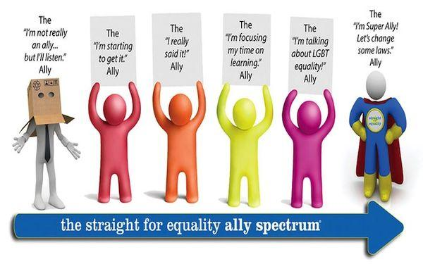
Ways to Be Supportive
http://www.straightforequality.org/
Notes:
Image Description: The image depicts the evolution of a person’s support as an LGBTQA+ ally from:
White stick figure in tie with paper bag on head and cut out eye holes “The “I’m not really an ally...but i’ll listen”. Ally”
Red stick figure “The “I’m starting to get it.” Ally”
Orange stick figure “The “I really said it” Ally”
Yellow stick figure “The “I’m focusing my time on learning.” Ally”
Bright purple pink stick figure “The “I’m talking about LDBT equality” Ally”
White stick figure in blue superhero spandex, yellow boots, and a red cape “The “I’m Super Ally! Let’s change some laws” Ally”
Allyship is a spectrum and depending on the topic and our own situation we may move forwards and backwards across the spectrum of allyship. Go to the link on this slide to access resources on the Straight For Equality website. http://www.straightforequality.org/

Slide 33
Institutional DEIR Considerations
Things:
Furniture, Space, Technology
Collections
Funding
People:
Administrators
Library Workers
Scientists & Students
Community
Notes:
Background Image Description: Black circuit board with blue circuits on the outer edges.

Slide 34
Key Concepts of
DEIR
Respect
Agency
Support
Notes:
Background Image Description: Black circuit board with blue circuits on the outer edges.
Without respect, agency, and support people feel unvalued and disengaged with their work. If you read studies from business, education, medicine, or other disciplines about what causes people to have good experiences and stay engaged, or to have bad experiences, in my experience, you can distill the factors down to respect, agency and support.

Slide 35
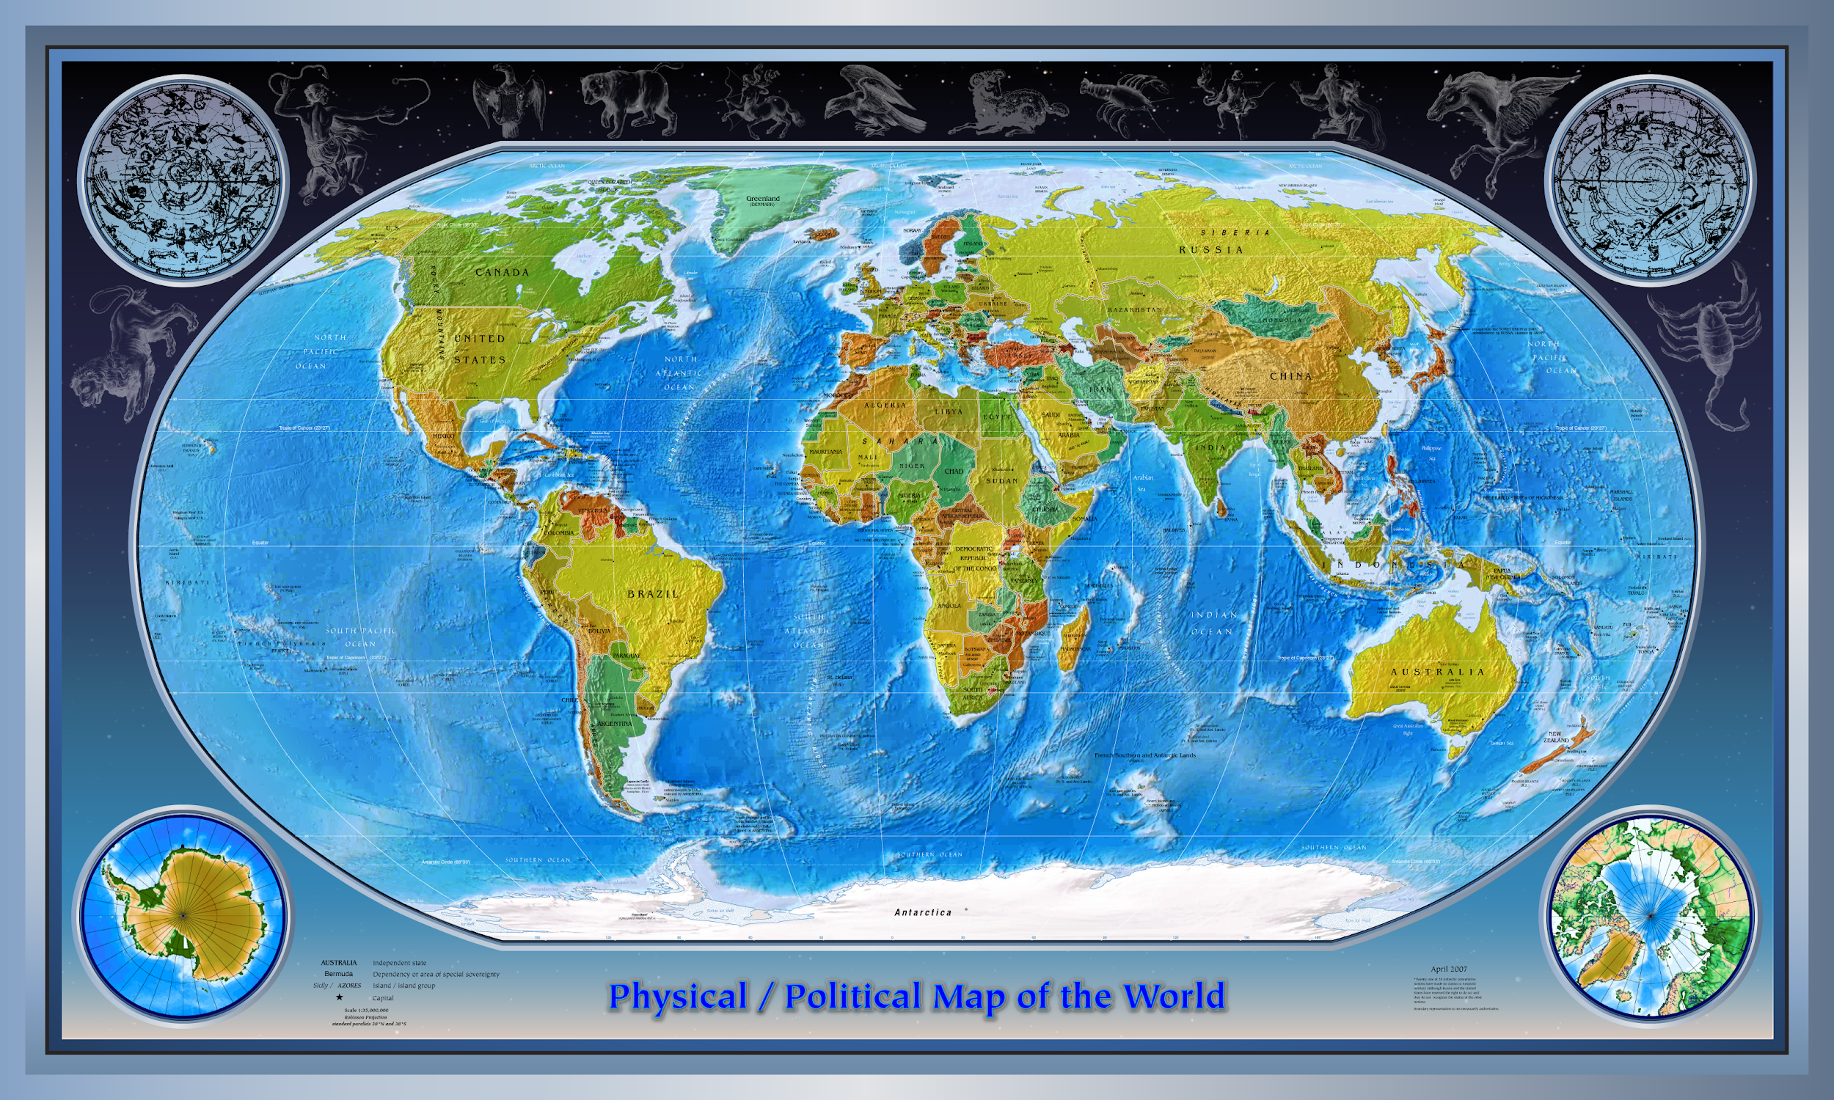
Micro-Cultures
Image Source: United States Central Intelligence Agency's World Factbook
Notes:
Image: Map of the world with blue water and green and brown land masses labeled Physical/Political Map of the World.
Personal Cultural Assumptions/Microagressions/expectations
Micro-cultures in different geographical locations
Examples: CA; Nebraska; Japan (personal bubbles); our stories -image of people in bubbles of different - standing close together or far apart
How to deal with it
People asking you how you are? Or saying hi to strangers on street in TX.
Same as in your place of work, being aware of and adapting to the culture
Image source link:
https://commons.wikimedia.org/wiki/File:Physical_Political_World_Map.png

Slide 36
Be relentlessly pleasant.
~ Nancy HoufeK, APS Workshop 2012
Listen and then Amplify.
Notes:
Background Image Description: Black circuit board with blue circuits on the outer edges.
When interacting and learning from others who have diverse backgrounds it is important to focus on listening and relating to the other person (or people) not your own understanding. You can do research at a later point in time to educate yourself further. People insistent that they are “owed” an explanation because they “don’t understand” cause psychological harm and long term trauma. No one wants to justify who they are.
Nancy Houfek is an expert in personal presentation and success. She was the Head of Voice and Speech for Harvard’s American Repertory Theater from 1997 to 2014. She has regularly presented at NSF funded career workshops on being strong and strategic. http://www.nancyhoufek.com/about.shtml

Slide 37
Library DEIR Articles for Consideration
Improving Diversity, Equity, and Inclusion in Libraries: Programs and Methodologies to Consider
https://doi.org/10.29242/rli.301.4
Kaetrena Davis Kendrick’s Research Articles
https://kaetrenadaviskendrick.wordpress.com/published-articles/
Notes:
Background Image Description: Black circuit board with blue circuits on the outer edges.

Slide 38
Journal of Chemical Education SciPop Article
Journal of Chemical Education SciPop Article: https://pubs.acs.org/doi/abs/10.1021/acs.jchemed.7b00070
Notes:
Image Description (Red, Yellow and Green circles orbit around a blue center representing an atom) Science + (Circle a Dragon, circle of a robotic hand, and a white explosion out of a blue hazard sign grouped together in circles representing pop culture topics) Pop Culture Equals sign (Exploding blue cloud with the word SciPOP in the middle in white with red, yellow and green, explosion lines) SciPOP Talks
Thanks to Erin Colonna and UNL Libraries for this great graphic which serves as the graphical abstract for our Journal of Chemical Education Article.

Slide 39
Things to Consider
Does the speaker want to represent their community?
Accessibility of the event, related materials, websites and recordings
Can you offer presenters more control over what is put online
Notes:
Background Image Description: Black circuit board with blue circuits on the outer edges.

Slide 40
Increasing DEIR
Honor
Sponsor &
Support
Diverse People
Take the Lead
Ask for Advice
Embrace Being Uncomfortable
Notes:
Background Image Description: Black circuit board with blue circuits on the outer edges.
In order to increase DEIR you need to honor, sponsor (nominate for positions and awards), and support (emotional, physically, and financially) diverse people.
If you have the time and emotional bandwidth take the lead on updating your materials or on a group working on changing policies.
Ask for advice when you need it, but do your own research first, you can learn a lot by using your research skills online, there are already tons of guides and advice written by experts that is freely available. Especially pay attention to things testimonials, reflections, suggestions and complaints written by individuals and groups about their lived experiences. There is no one size fits all solutions, don’t assume that local groups and individuals experience the same issues the exact same way as people elsewhere.
Embrace being uncomfortable, this is uncomfortable work. Take time to think about and reflect on things, especially things you instinctively find upsetting or offensive. Do more research on your own and try to understand why you are upset or offended and why your point of view differs.

